Slide 1
RoundTable Discussion
Zhenwen(Wayne) 11/15/2018

Slide 2
Final Project
Grid
Distortion
Moiré
pattern
Data
Visualization
Aurora
Simulation

Slide 3
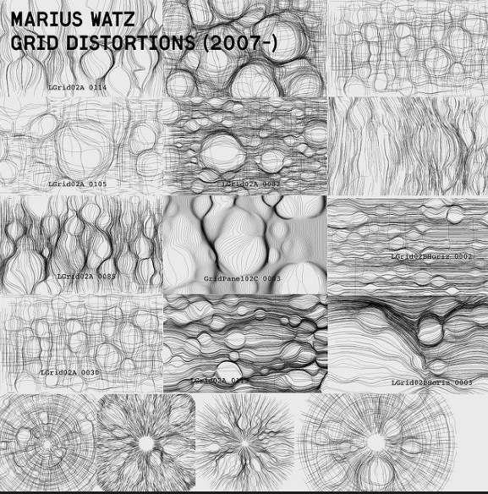
Grid Distortion
Marius Watz-Artist
CIRCGRID
Interactive Narrative
Affected by sound
Camera-based interaction

Slide 4
Moiré Pattern
Moiré pattern
Examples
Exploring Moiré Patterns
Using Moiré pattern to design some interesting visualizations
Interactive Narrative/Persuasion
Dynamic growing
Be interactive in some fashion with the mouse/key

Slide 5
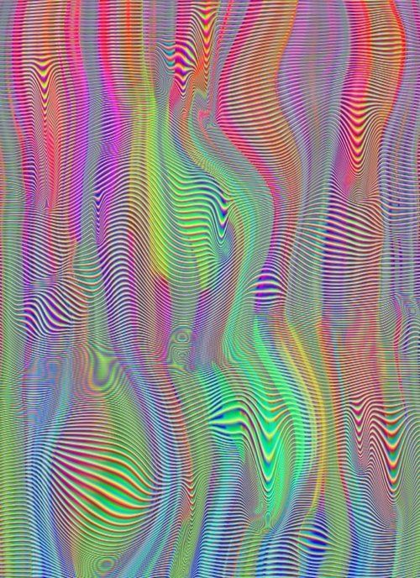
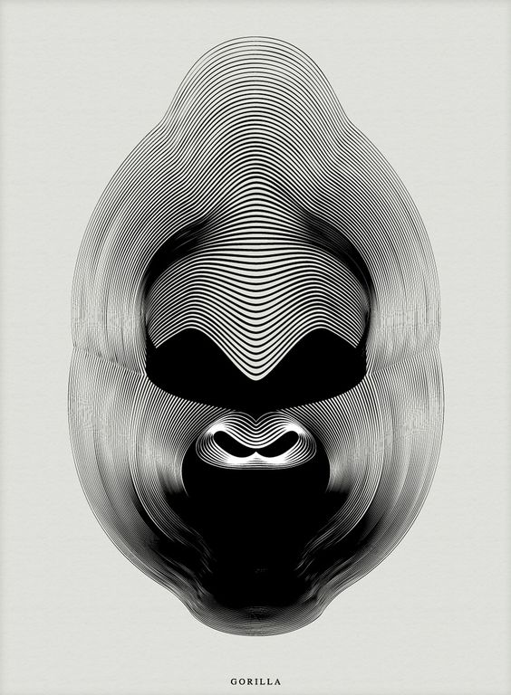
Moiré Pattern

Slide 6
Data Visualization
Jer Thorp-Data Artist
Just Landed - 36 Hours
He extracted travel information from people’s public Twitter streams by searching for the term ‘Just landed in…’.
One day in MTA???
Explore the connection between the cinema and subway station (NYC)???
See the Manhattan’s skyline change over time???

Slide 7
Aurora Simulation
Interactive Narrative
Changing over time
Be interactive in some fashion with the mouse/key
Reflection

Slide 8

Thank you

